Slide 1


Name
Department
Semester
<Uttiyo Modak>
ECE.
5TH-Sem
Name
Department
Semester
<Tanushree Das>
ECE.
5TH-Sem
Name
Department
Semester
<Subhabrata Mondal>
ECE.
5TH-Sem
Name
Department
Semester
<Suman Chakraborty>
ECE.
5TH-Sem
SORCERERS
WARHOUSE ROBOTS
<RED> | <QUESTION NO.3>

Slide 2

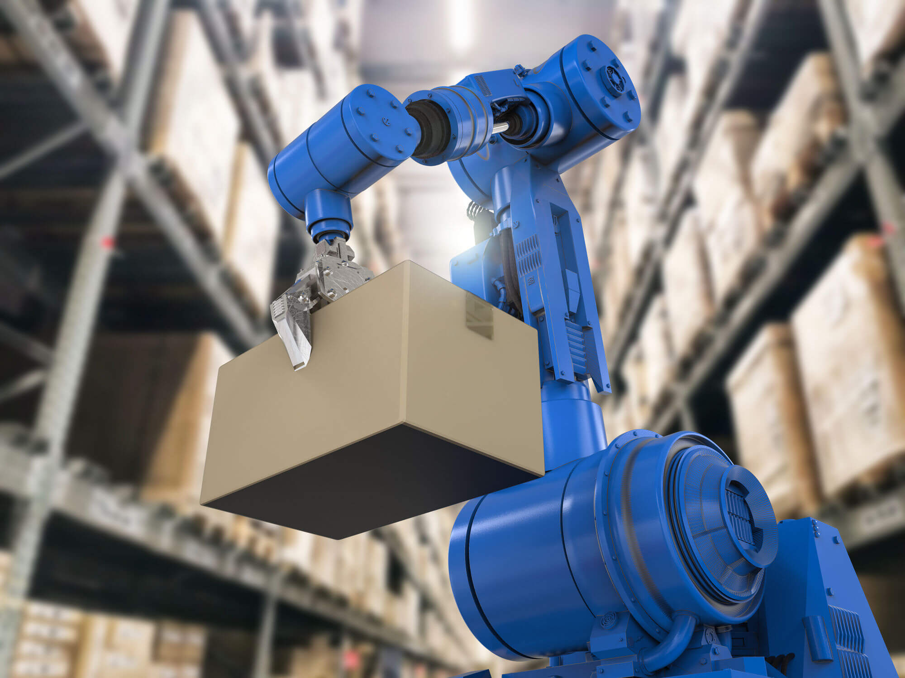
PROBLEM STATEMENT & OBJECTIVE
Problem Statement:
Create a network of IoT-enabled warehouse robots: Coordinate their movement and tasks to optimize storage and retrieval.(Red House & Question Number:3)
What's the Problem?
Objective:
This project aims to design an IoT-enabled warehouse robotic system that coordinates movement and task allocation to optimize storage and retrieval to enhance efficiency and accuracy while minimizing manual effort and human error.
01

Slide 3
TOPIC & PROPOSED SOLUTION
Background:
Efficient warehouse management is critical in modern supply chains. With increasing demand for fast deliveries and large-scale inventory handling, traditional manual methods face significant challenges.
Why the Problem Matters?
Warehouses need fast and accurate operations.
Manual methods are slow, costly, and error-prone.
Hard to achieve real-time tracking and coordination.
Rising demand for automation and efficiency.
IoT-enabled robots provide smart coordination and optimization.
Why It Matters
02

Slide 4
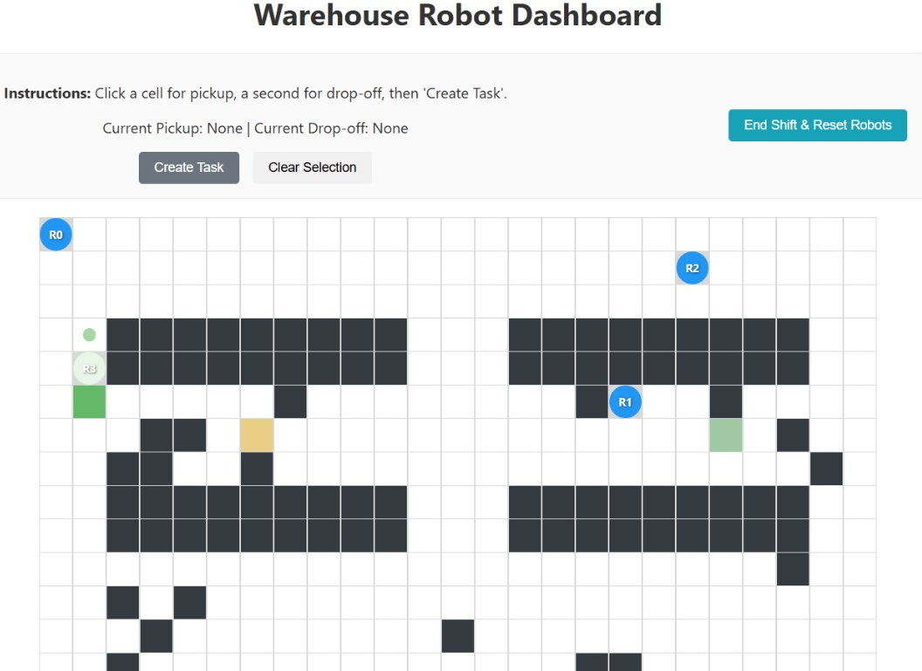
TOPIC & PROPOSED SOLUTION
What’s new or different in our system :
It uses an IoT network, so all robots stay connected.
Robots can work together as a team, not just individually.
Tasks are given in real-time, instead of following fixed schedules.
Robots follow smart routes to save time and avoid traffic inside the warehouse.
The system is flexible and scalable, so it can grow with warehouse needs.
It can be upgraded with AI in the future to make even smarter decisions.
Our Big Idea
03

Slide 5
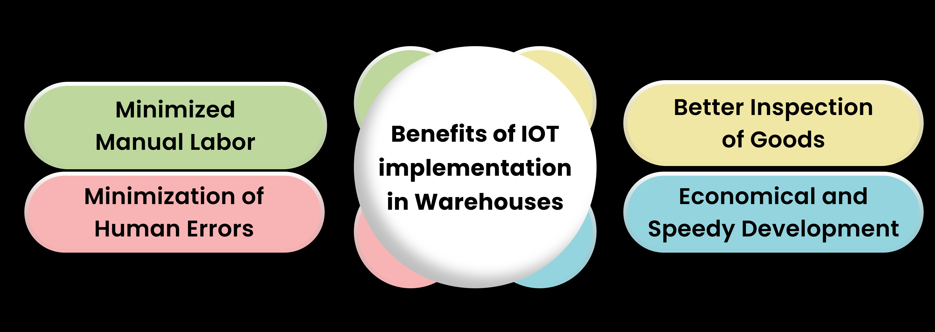
TOPIC & PROPOSED SOLUTION
Benefits:
Why It’s Cool
What Makes It Unique?
Uses an IoT-based communication network, unlike traditional standalone robots
Provides real-time coordination among multiple robots, ensuring smooth workflow
Dynamic task allocation, not fixed scheduling, making it adaptive to changing needs
Smart path planning to reduce congestion and save time, unlike basic navigation systems
04

Slide 6
CIRCUIT DIAGRAM
Wiring Up
05

Slide 7
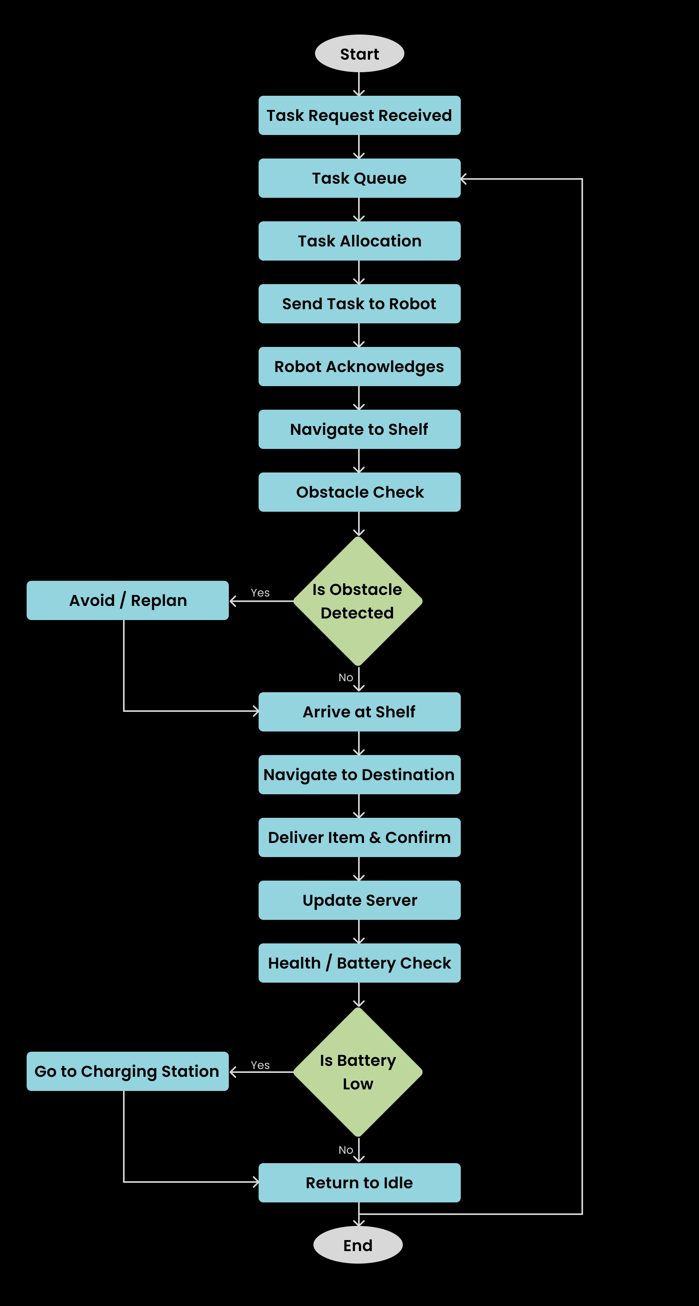
FLOWCHART
Start
Task Request Received → Order / packing request arrives into system.
Task Queue → All pending / deliver tasks are listed.
Task Allocation → Server chooses the best robot: nearest + battery + load.
Send Task to Robot → MQTT / HTTP command with shelf location + destination.
Robot Acknowledges → robot confirms task accepted.
Navigate to Shelf → robot follows line / path, uses sensors.
Obstacle Check →
If obstacle detected: Avoid / Replan, then return to Navigate.
Else: continue.
Arrive at Shelf → Picks the item, scan RFID / QR to confirm.
Navigate to Destination → again with Obstacle Check loop.
Deliver Item & Confirm → drop item, send confirmation.
Update Server → task complete, logs sent, update inventory.
Health Check / Battery Check →
If battery low: Go to Charging Station (or mark unavailable).
Else: Return to Task Queue (ready for next assignment).
End.
How It Works
06

Slide 8
TECHNOLOGY STACK
Software Components:
Python: Core programming for simulation, data handling, and AI modules.
C: Used in Arduino firmware for low-level hardware control.
Dijkstra’s Algorithm: Optimizes shortest path navigation for the robot.
KNN Mapping: For path classification and decision-making in navigation.
VS Code: Primary development environment for coding & debugging.
NumPy: Supports matrix operations, sensor data processing & calculations.
Flask: Lightweight backend for IoT dashboard and communication.
HTML, CSS, JS: Frontend interface for monitoring and controlling robot.
Hardware Components:
Control Unit – Arduino Uno (prototype) → Industrial MCU / Raspberry Pi (scalable)
Motors & Drive – DC geared motors (prototype) → BLDC/Stepper motors with encoders (scalable)
Sensors – LDRs (line tracking), Ultrasonic (obstacle) → LiDAR / Camera vision (scalable)
Power Supply – 9V–12V battery pack (prototype) → Li-ion battery pack with BMS (scalable)
Chassis – Acrylic/metal frame (prototype) → Aluminum/steel load-bearing structure (scalable)
Indicators – LEDs (status), Buzzer (alerts)
Communication – ESP8266/ESP32 Wi-Fi module (for cloud connectivity)
Tech Stuff
Additional Software/
Simulation Components
(can be done):
ROS 2
Gazebo:
MQTT Protocol:
LIDAR.
MongoDB
07

Slide 9
CHALLENGES & SOLUTIONS
ENGINEERING PROCESSES:
Simulation in Tinkercad → test core control logic (sensors, navigation).
Prototype with scaled components → validate line-following & obstacle detection.
Scalable architecture → final design will use BLDC/stepper motors with gear reduction and stronger frame to handle heavier payloads, replacing DC motors used in the prototype.
COST:
Human labour for repetitive material movement → recurring expense.
Our prototype: low-cost automation (~₹2,500–₹3,000).
Scalable to larger robots → one-time investment, reduces long-term operational cost.
ACCURACY:
Manual handling → prone to fatigue & errors.
Our system: sensor-based (LiDAR + ultrasonic) → ensures reliable line following & obstacle detection.
Cloud integration → data logging improves efficiency tracking.
Hurdles & Fixes
08

Slide 10
REFERENCES & PROJECT LINKS
PROJECT LINKS:
GitHub Repository (Team Sorcerers): https://github.com/erringexplorer267/Sorcerers
Demo YouTube Video Link:
Where We Got Help
REFERENCES:
Open Source Robotics Foundation. (2023). ROS 2 Documentation. Retrieved from https://docs.ros.org
Robot Operating System. (2023). Gazebo Simulator. Retrieved from https://gazebosim.org
MQTT. (n.d.). MQTT: The Standard for IoT Messaging. Retrieved from https://mqtt.org
MongoDB, Inc. (2023). MongoDB Documentation. Retrieved from https://www.mongodb.com/docs
NumPy Developers. (2023). NumPy User Guide. Retrieved from https://numpy.org/doc
Flask Community. (2023). Flask Documentation. Retrieved from https://flask.palletsprojects.com
09

